Slide 1
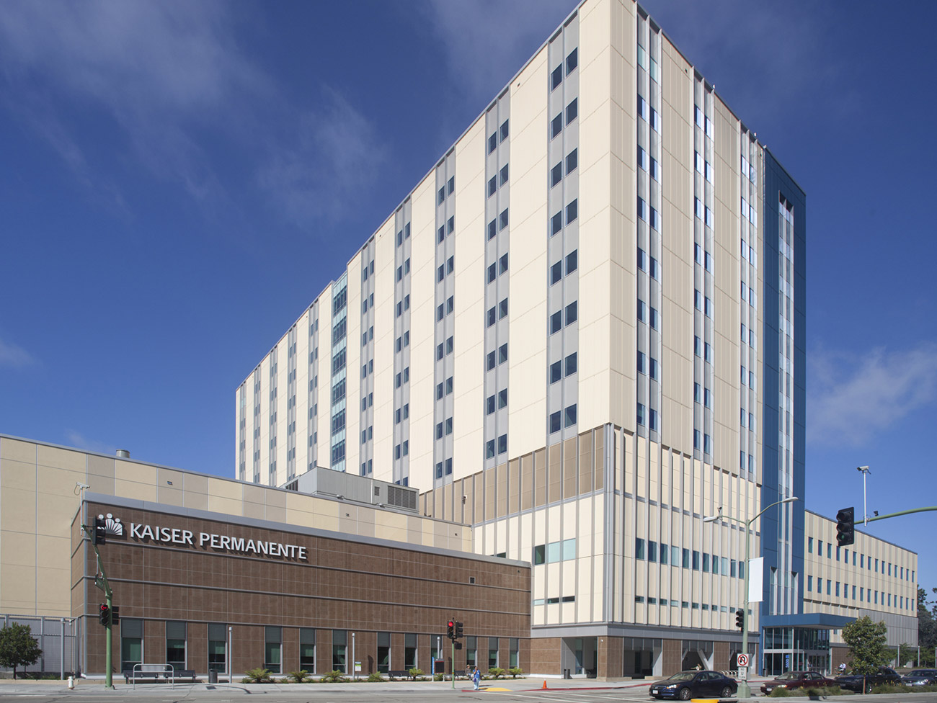
KAISER PERMANENTE, OAKLAND, CALIFORNIA
PRESENTED BY:
GMU GIRLS
ASHWINI PRIYANGA SURESH
MEAAD HARISI
SUHA SAEED S. AL THABIT
YATISHA RAJANALA
HAP-678-001 – Team Project Presentation
Spring 2023

Slide 2

OVERVIEW
Nonprofit Organization Established in 1945 by Industrialist Henry J. Kaiser and Physician Dr. Sidney Garfield
Serves Rural and Urban Communities with Health Insurance and Medical Care Services to over 12.4 Million Members
Spread across Nine States in the U.S.A.: California, Colorado, Georgia, Hawaii, Maryland, Ohio, Oregon, Virginia, and Washington D.C.
Headquarters: Kaiser Permanente, Oakland, California
Centers of Excellence:
Kaiser Permanente Center for Reproductive Health
Kaiser Permanente Center for Sleep Disorders
Kaiser Permanente Center for Advanced Care

Slide 3
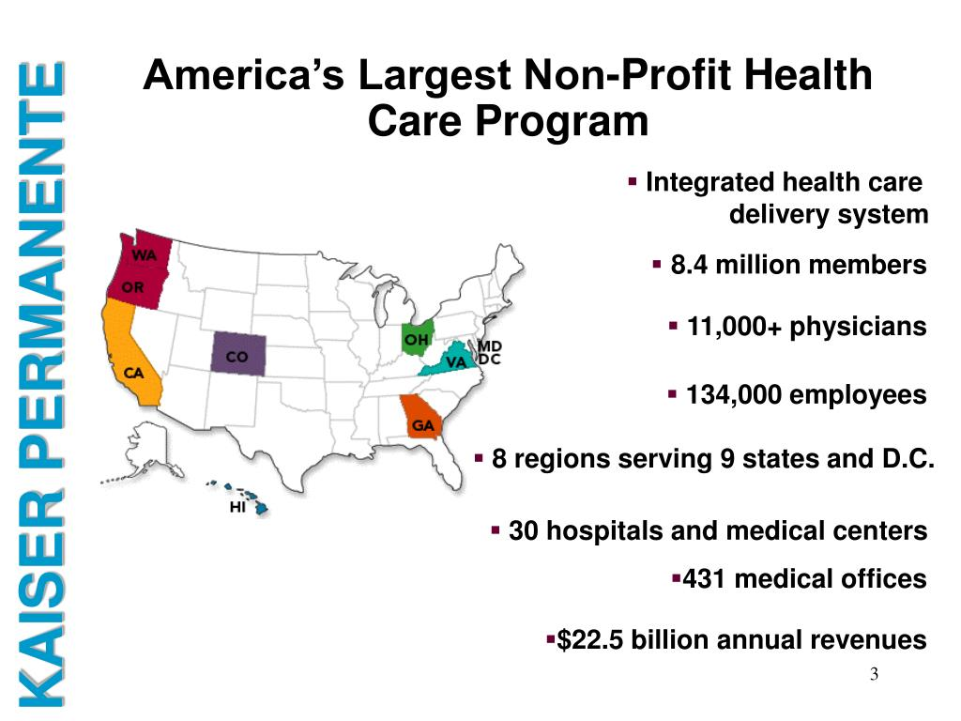

Slide 4
“Kaiser Permanente exists to provide high-quality, affordable health care services and to improve the health of our members and the communities we serve.”
STRATEGIC GOALS AND OBJECTIVES
Improvement of Population Health by addressing Social Determinants of Health
Enhancement of Patient Experience by providing Patient-Centered Care
Investment in Digital Health Technologies to upgrade Access To Care
Expansion of Mental Health Services to improve the Mental Health Needs of its Members
Reduction of Healthcare Costs through Advanced Care Management And Coordination

Slide 5
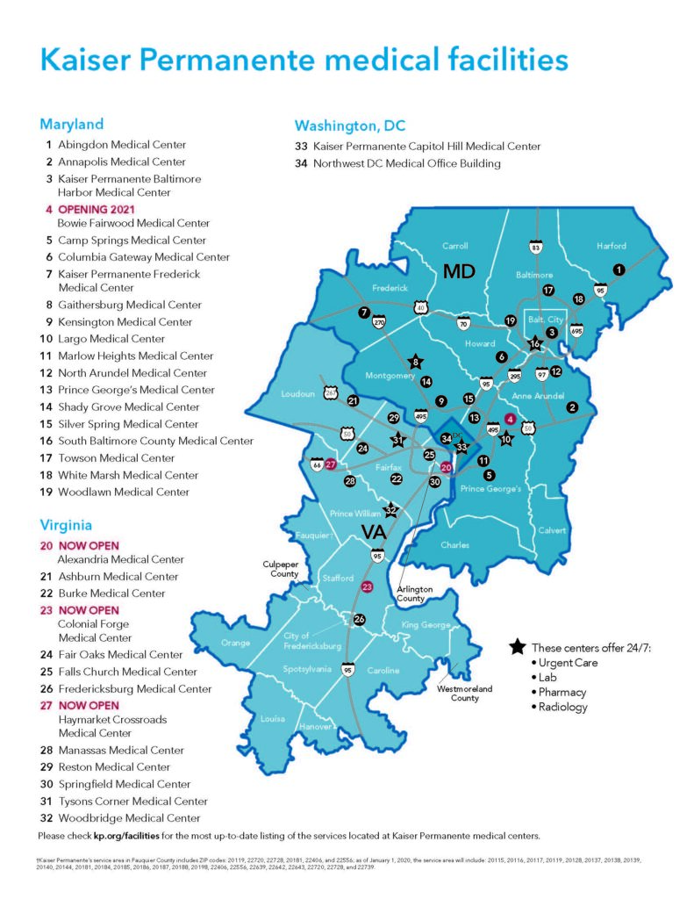
KEY STATEMENT VALUES
Patient First Priority
Emphasize on Prevention and Wellness
Promote Equity and Inclusion
Foster Innovation and Continuous Improvement
Demonstrate Excellence and Accountability in all Aspects of Care
Fair Treatment to All

Slide 6
In 2021, the U.S. Green Building Council identified Kaiser Permanente as the Top Health Care Organization in the world for the total of 65 LEED – Certified (Leadership in Energy and Environmental Design) buildings.
ACCOLADES
Kaiser Permanente was again among the Highest – Rated Health Plans in the nation, according to the 2021 National Committee for Quality Assurance’s Health Plan Ratings, for providing expert coordinated care and outstanding service to its members and patients.
Kaiser Permanente is ranked Number One in the U.S.A. in terms of LEED – Certified Health Care Square Footage, with a total area of 6.9 Million Square Feet.

Slide 7

ORGANIZATIONAL STRUCTURE

Slide 8
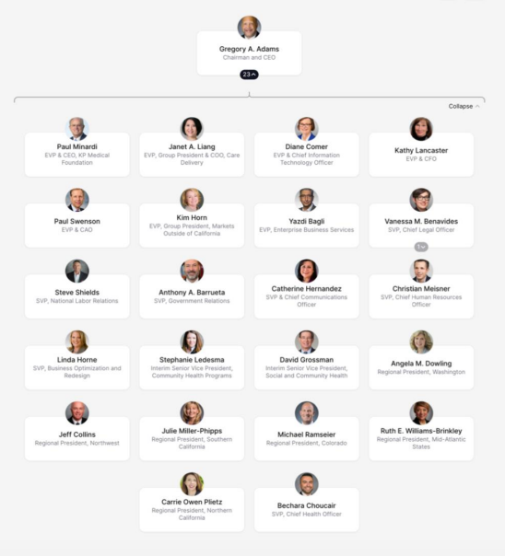
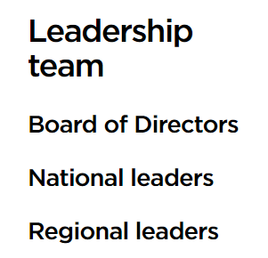
ORGANIZATIONAL
HIERARCHY
AND
GOVERNANCE

Slide 9
Over Two-Thirds of the Health Care Workforce (69%) comprises members of Underrepresented and historically Marginalized Groups.
Launch of the Virtual Care Innovation Network Program to bring together safety net organizations across the communities to Redesign Care, so that, virtual care models continue to thrive and improve access after the pandemic abates.
POST – PANDEMIC INITIATIVES
Kaiser Permanente has invested over $71 million in more than 200 Community-Based Organizations to address Misinformation, support Social Needs, remove Barriers to Vaccine Access, and deploy Grassroots Strategies to increase the uptake of COVID-19 Vaccines.
Expenditure of $2.98 Billion on small suppliers and businesses owned by Women, people of Color, and other Underrepresented Groups in 2021, indicating nearly 48% increase over pre-pandemic levels.
Provision for more than 9.4 Million Video Visits and 15.8 Million E-visits using the kp.org Member Website and Mobile App — more than 3 times as many as in 2020.

Slide 10
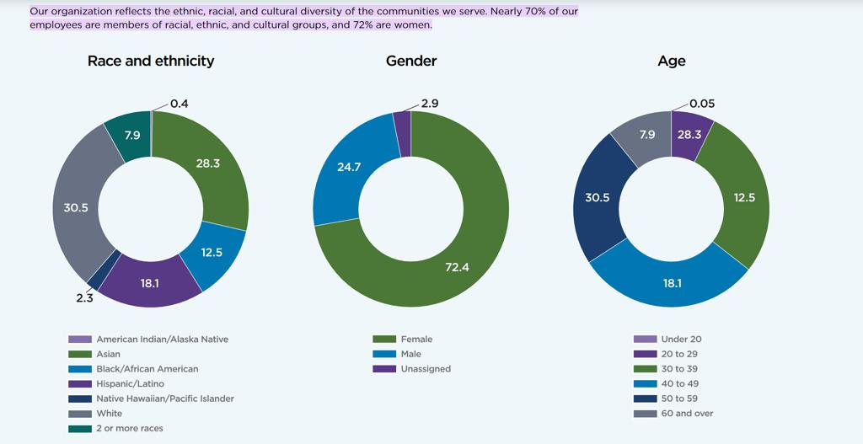
A WORKPLACE FOR ALL

Slide 11
KAISER PERMANENTE COMPETITORS
Kaiser Permanente’s Competitors include Dignity Health, Mayo Clinic, Change Healthcare and Health Net Federal Services.
Net Promoter Score
7/10
Employee Net Promoter Score
20/25
Pricing Score
3.3/5
Gender Equity Score
76/100
Customer Service Score
3.4/5
Diversity Score
77/100
Overall Culture Score
73/100
Product Quality Score
3.4/5
CEO Score
71/100

Slide 12
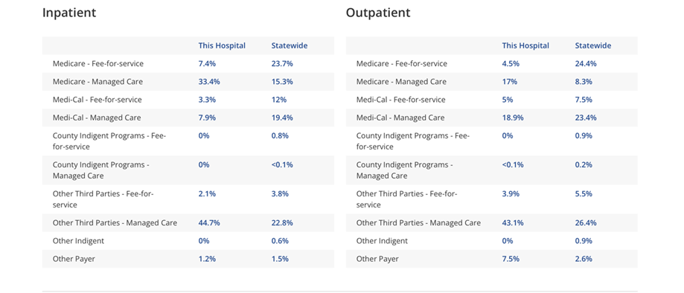
PAYER MIX

Slide 13
KAISER PERMANENTE’S HEALTH PLANS
HMO Plans
(Health Maintenance Organization)
Kaiser Permanente's HMO plans provide members with access to a Network of Healthcare Providers and facilities within the Organization's Integrated Healthcare System. Members typically pay a Fixed Monthly Premium and are required to select a primary care physician to coordinate their care.
PPO Plans
(Preferred Provider Organization)
Kaiser Permanente's PPO plans allow members to receive care from both In-Network and Out-of-Network Providers. Members typically pay a Higher Monthly Premium for this flexibility.
POS Plans
(Point – Of – Service)
Kaiser Permanente's POS plans provide members with the flexibility to receive care from Healthcare Providers Outside of the Organization's Network, but at a Higher Cost. Members are also able to receive care from Kaiser Permanente Providers at a Lower Cost.
EPO Plans
(Exclusive Provider Organization)
Kaiser Permanente's EPO plans are situated between an HMO and PPO in terms of flexibility and costs. With an EPO, members typically Do Not Need a Referral to see a specialist.

Slide 14
DEPARTMENTS/UNITS OF SPECIAL CARE SERVICES
Cancer Screening Programs
Genetic Testing
Clinical Trials
Multidisciplinary Cancer Care Teams
Palliative Care
Survivorship Programs
Virtual Care
Drive-Up Testing
Home Monitoring
Vaccine Distribution
Care for Vulnerable Populations
Dedicated COVID-19 Units
Perinatal Care Program
Breastfeeding Support
Centering Pregnancy Program
High-Risk Pregnancy Program
Neonatal Intensive Care Unit (NICU)
CANCER CARE
COVID – 19 CARE
MATERNITY CARE
CARDIAC CARE
MENTAL HEALTH AND WELLNESS
Integrated Cardiac Care Program
Cardiac Rehabilitation Program
Telehealth Cardiology Program
Cardiovascular Risk Reduction Program
Integrated Behavioral Health Program
Teen Mental Health Program
Military Veterans Program
Mental Health and Wellness Center
Mindful Awareness Practices (MAP) Program

Slide 15

KP HEALTH CONNECT
An Integrated And Comprehensive Health Care Business System
QUALITY
SERVICE
AFFORDABILITY
Clinical Information Available 24/7.
Unsurpassed Clinical Outcomes.
Real-Time Clinician Access to Recommended Best Practices.
National Leadership in Patient Safety.
Enhanced Research Capabilities to Support Evidence-Based Care.
Up-To-Date Clinical and Patient Preferences.
Enhanced Personalized Care.
Information Provided to Patients for Shared Decision Making.
Patient Access to Information via Telephone, Web, and Secure Messaging.
Support for Patients’ Participation in their own Self Care Journey.
Efficient Access to Care to Minimize Wait Times and Out-Of-Pocket Costs.
Superior Integration and Continuity Of Care across Specialists, Settings, and Time.
Reduced Cost of Care And Improved Visit Experiences.
Elimination of Waste associated with Paper Medical Records or Missing Medical Records.
Elimination of Costly In-person Services unless Medically Necessary or Desired by the Patient.
Streamlined IT Administrative Processes and Costs.

Slide 16
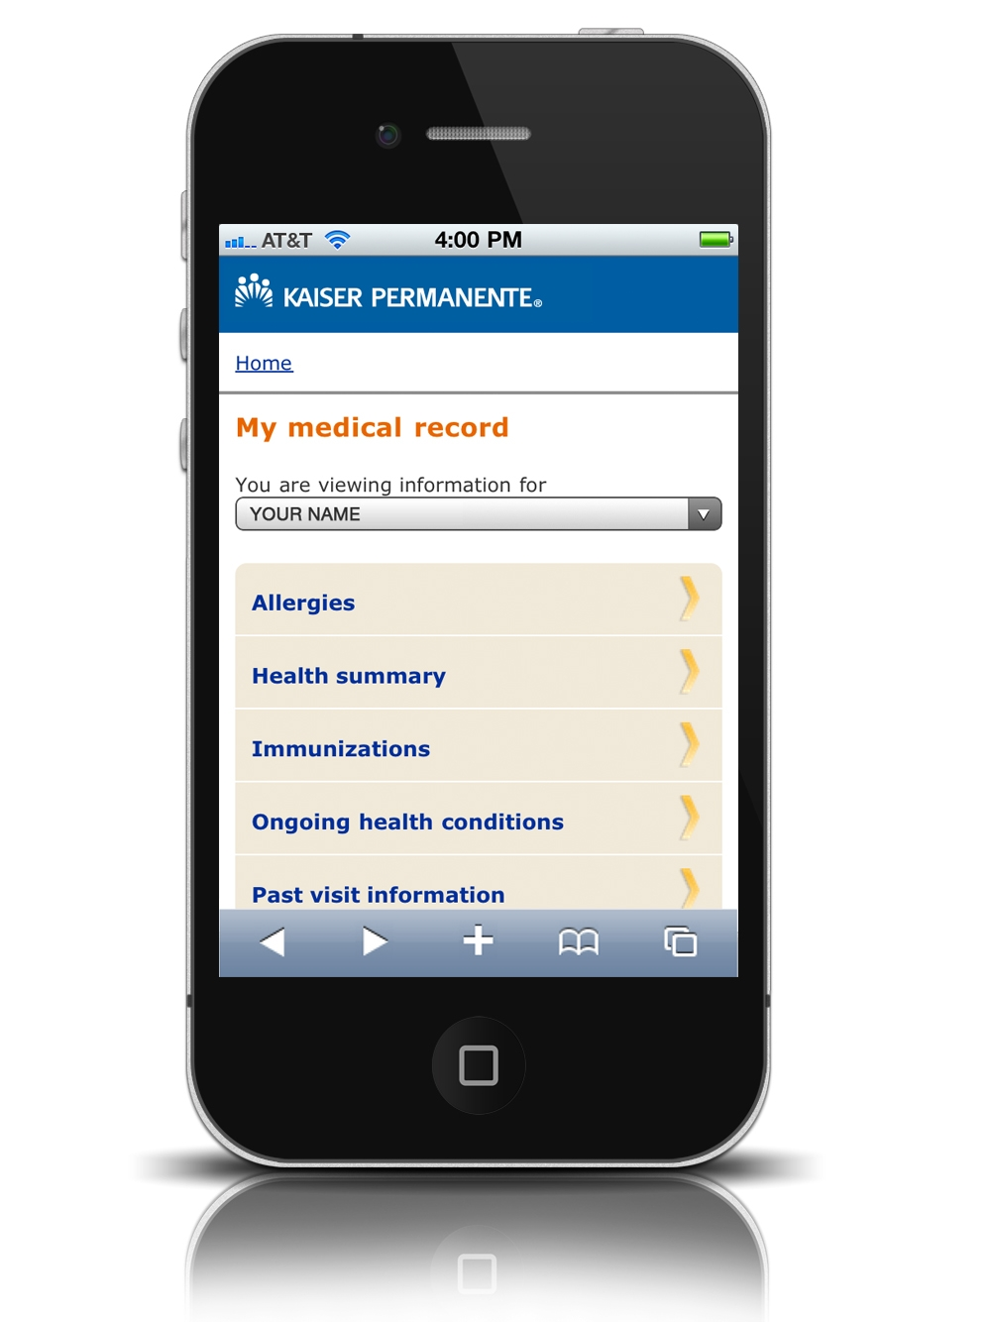
KP MOBILE APP
Salient Features Of The Application
Emails sent to the Doctor’s Office or Member Services with Non-urgent Questions.
Schedule, View, and Cancel Routine Appointments and see information about Past Visits.
Fill or Refill most Prescriptions, Check the Status of a Prescription Order, and see a List of all the Medications.
Get Care in a way that works for individual patients — Online, by Phone, or In-Person.
Access to Digital Membership Card to Check-in for Appointments, Pick-up Prescriptions, and many more.
Get Personalized Reminders and Health Information as soon as they’re Available.
View the Patient’s Medical History, including Allergies and Immunizations, Ongoing Health Conditions, and most Lab Test Results.
Choose a Doctor by Browsing the Online Doctor Profiles.
Find nearby Facilities and Pharmacies.

Slide 17
KP MEDRITE PROGRAM FOR NURSES
An Innovative Program To Reduce Medication Errors
STAGES
COMPONENTS
OUTCOMES
MedRite Process Workflow
No Interruption Wear (NIW)
Sacred Zone Workplace
Following Medication Administration Guidelines.
Wristband Barcode Medication Administration (BCMA) Technology.
Medication Safety Education on high-alert drugs, look-alike/sound-alike medications, etc.
Improved Medication Safety
Reduced Medication Errors
Team-Based Approach
Use of Evidence-Based Guidelines and Protocols
Nurse Training Support and Confidence
Improved Nurse Satisfaction

Slide 18
THANK YOU
REFERENCES
Fast facts. (n.d.). About.kaiserpermanente.org. https://about.kaiserpermanente.org/who-we-are/fast-facts
High-quality health care for all. (n.d.). Kaiser Permanente. Retrieved May 1, 2023, from https://healthy.kaiserpermanente.org/northern-california/learn/highqualitycare
IHI Kaiser Permanente. (2019). Ihi.org. https://www.ihi.org/kaiser-permenente/
Kaiser Permanente’s Innovation on the Front Lines. (2010, September). Harvard Business Review. https://hbr.org/2010/09/kaiser-permanentes-innovation-on-front-lines
KFF. “The Henry J. Kaiser Family Foundation.” The Henry J. Kaiser Family Foundation, The Henry J. Kaiser Family Foundation, 2019, www.kff.org/
Mobile App: Good Health on the Go | Kaiser Permanente. (n.d.). Healthy.kaiserpermanente.org. Retrieved May 1, 2023, from https://healthy.kaiserpermanente.org/northern-california/pages/mobile-app
Our Model. (n.d.). About.kaiserpermanente.org. https://about.kaiserpermanente.org/commitments-and-impact/public-policy/integrated-care
Welcome. (n.d.). KP International | Kaiser Permanente International. Retrieved May 1, 2023, from https://international.kaiserpermanente.org/
“We’re Transforming Health and Health Care – Find out How.” Kaiserpermanente.org, 2 Apr. 2019, https://.about.kaiserpermanente.org/

